Slide 1
Western Regional Haze Planning and
EGU Emissions Analysis Project – Phase 1
February 25, 2019 WebEx
Overview of regional haze modeling process and state level analysis
Tom Moore

Slide 2
EGU Emissions Analysis Project – expert support
CNEE role – Phase 1
Data collection and presentation
Interface with states and utilities on data review
Draft reports and coordinate review and comment
Finalize reports

Slide 3
Project Tasks
Compile a comprehensive database of information on the fleet of fossil-fired EGUs in 13-Western states (circa 2014-2017) that contains information on the plants operating characteristics and emissions
Develop a projection of 2028 EGU emissions that incorporates expected plant closures, fuel switching, and emission controls under a “rules on the books” scenario.

Slide 4
EGU Emissions Data for western interconnect + Dakotas
2014 Western EGU Emissions | SO₂ (tons) | NOx (tons) | Avg. NOx Rate (lb/MMBtu)
Coal | 221,476 | 321,306 | 0.253
Natural Gas | 520 | 12,017 | 0.016
Coal % | 100% | 96% | Coal = NG x 16
Natural Gas % | 0% | 4%
13 Western State EGU Emissions
 | SO₂ (tons) | NOx (tons)
2014 to 2017 | -38% | -33%

Slide 5
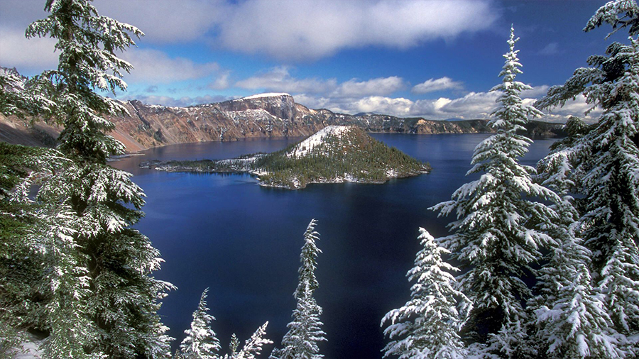
Western Regional Haze Analysis – WRAP 2018-19 Workplan
Large regional effort underpins more local analysis work of WRAP member agencies
Purpose is to set Reasonable Progress Goals to improve visual air quality at over 100 individual, protected Class I areas
Also used to assess regional transport of ozone and other pollutants
Focus is on continuing SOx and NOx emissions reductions
Evaluation work:
Monitoring data chemical species mix and trends 2000 through 2019
Emissions data for 2014 through 2017 timeframe and 2028 projection year
Regional air quality modeling to apportion
contributions of upwind source categories and states
Control strategy analysis results from each state for
individual sources to be summed for testing in
regional modeling

Slide 6
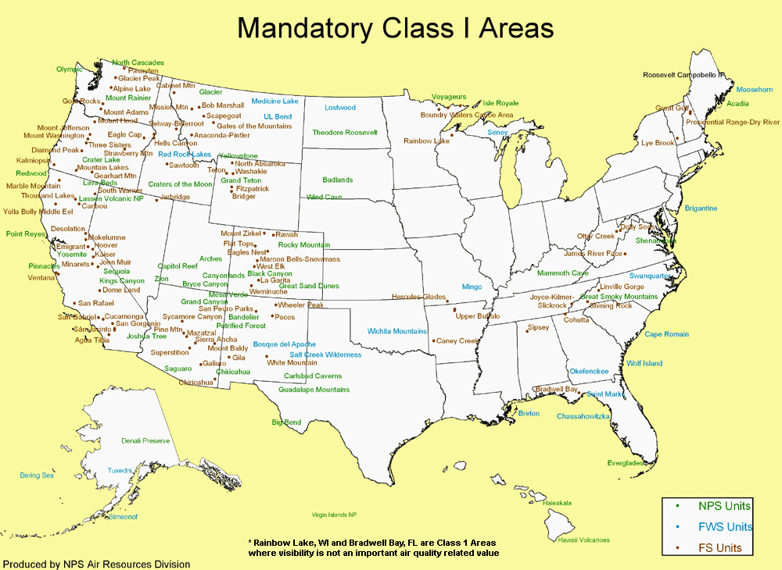
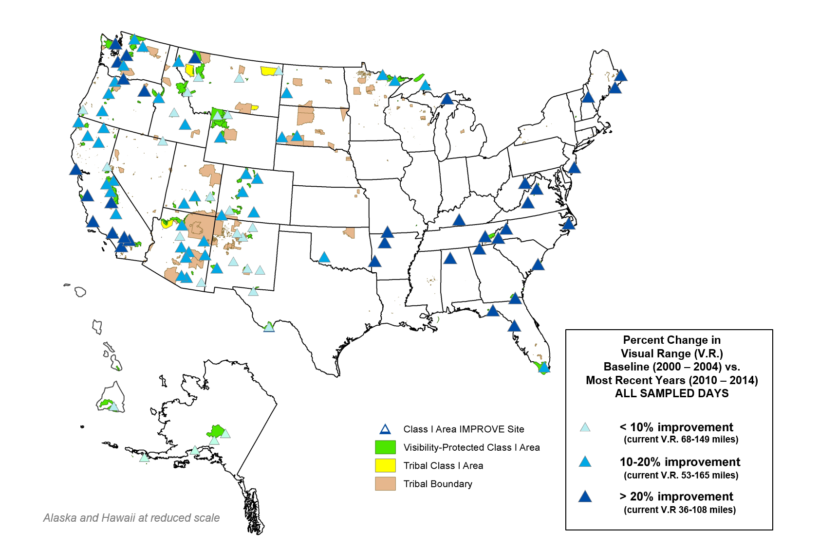

Slide 7
Process to use 2014 and 2014-17 baseline emissions data
Actual 2014 data used to test regional modeling performance in terms of using model for future-year (2028) modeling
2014 v1 modeling with CAMD data underway, complete in April
2014 v2 modeling to be completed by end of May – corrections/changes
2014-17 Representative Baseline modeling in June
Results from this project, “averaged fire emissions”, and improved O&G emissions will all be used
Basis of planning and projections – not data for model performance
Move then to projected 2028 air quality / visibility modeling

Slide 8
Process to use projected 2028 emissions data
2028 projections are needed for all anthropogenic and controllable source sectors in the region
Unit- or process-level projections are to be from a representative baseline value from the 2014-17 timeframe
Then projected to 2028 in terms of reasonable, representative assumptions about emissions, accounting for “On-the-Books / On-the-Way” (OTB/OTW) controls and documented operational assumptions
Goal is treat all units equitably in terms of future emissions
Such that 2028 modeled air quality / visibility impairment from OTB/OTW emissions does not choose one region or any source to be controlled
Consistency important for regional analysis

Slide 9
Regional air quality modeling to apportion contributions of upwind source categories and states
Regional modeling of all sources is used to calculate 2028 visibility improvement at each Class I area, with no additional controls
Using annual emissions rates expected in 2028, i.e., “on the books, on the way” emissions rates
OTB/OTW emissions rates are then used in the modeling
Provide transparent regional data for all states and sources
OTB/OTW air quality modeling results then:
Set the visibility goal at each Class I area if no more controls are added
If the predicted goal from OTB/OTW modeling is less that the nominal EPA target, a state may choose to define that value as achieving “reasonable progress” at that Class I area, i.e., no additional controls are needed
Inform each individual state’s decision about considerations for additional control analyses

Slide 11
After each state conducts their analysis – those results from each state for individual sources will be summed for testing in regional modeling
4 statutory factors for state analysis are:
The costs of compliance
The time necessary for compliance.
The energy and non-air quality environmental impacts of compliance.
The remaining useful life of any potentially affected major or minor stationary source or group of sources.
WRAP “Reasonable Progress Source Identification and Analysis Protocol for Second 10-year Regional Haze State Implementation Plans” document
In development, to be released in May
Aligns with EPA Regional Haze planning guidance in its current form
Addresses consideration of Visibility (5th Factor) for Stationary Source Controls
Provides reference document for individual states to use in applying 4 factors and their individual state control strategy evaluation processes
States generally targeting data for additional % potential controls by late 2019

Slide 12
Questions and Discussion

